Slide 1
Home Credit Project
Predicting Consumer Credit Defaults
Druce Vertes Metis Data Science Bootcamp October 31, 2018

Slide 2
The Problem
•Problem
Baseline model
Improved model
Future improvements
Challenge 1ΩΩz
Company
Context
Problem
Home Credit is an international consumer lender, founded in the Czech Republic, that uses alternative data to model and issue credit cards and consumer loans.
Lending to someone who pays on time is profitable.
Lending to someone who doesn’t pay it back is unprofitable.
8.1% of approved loans in this data set defaulted.
Predict likelihood of default using
Application data
Previous applications
Credit reports
Payment history

Slide 3
Target Variable:
1 - Client with payment difficulties: he/she had late payment more than X days on at least one of the first Y installments of the loan in our sample
0 - all other cases
•Problem
Baseline model
Improved model
Future improvements
Challenge 1ΩΩz

Slide 4
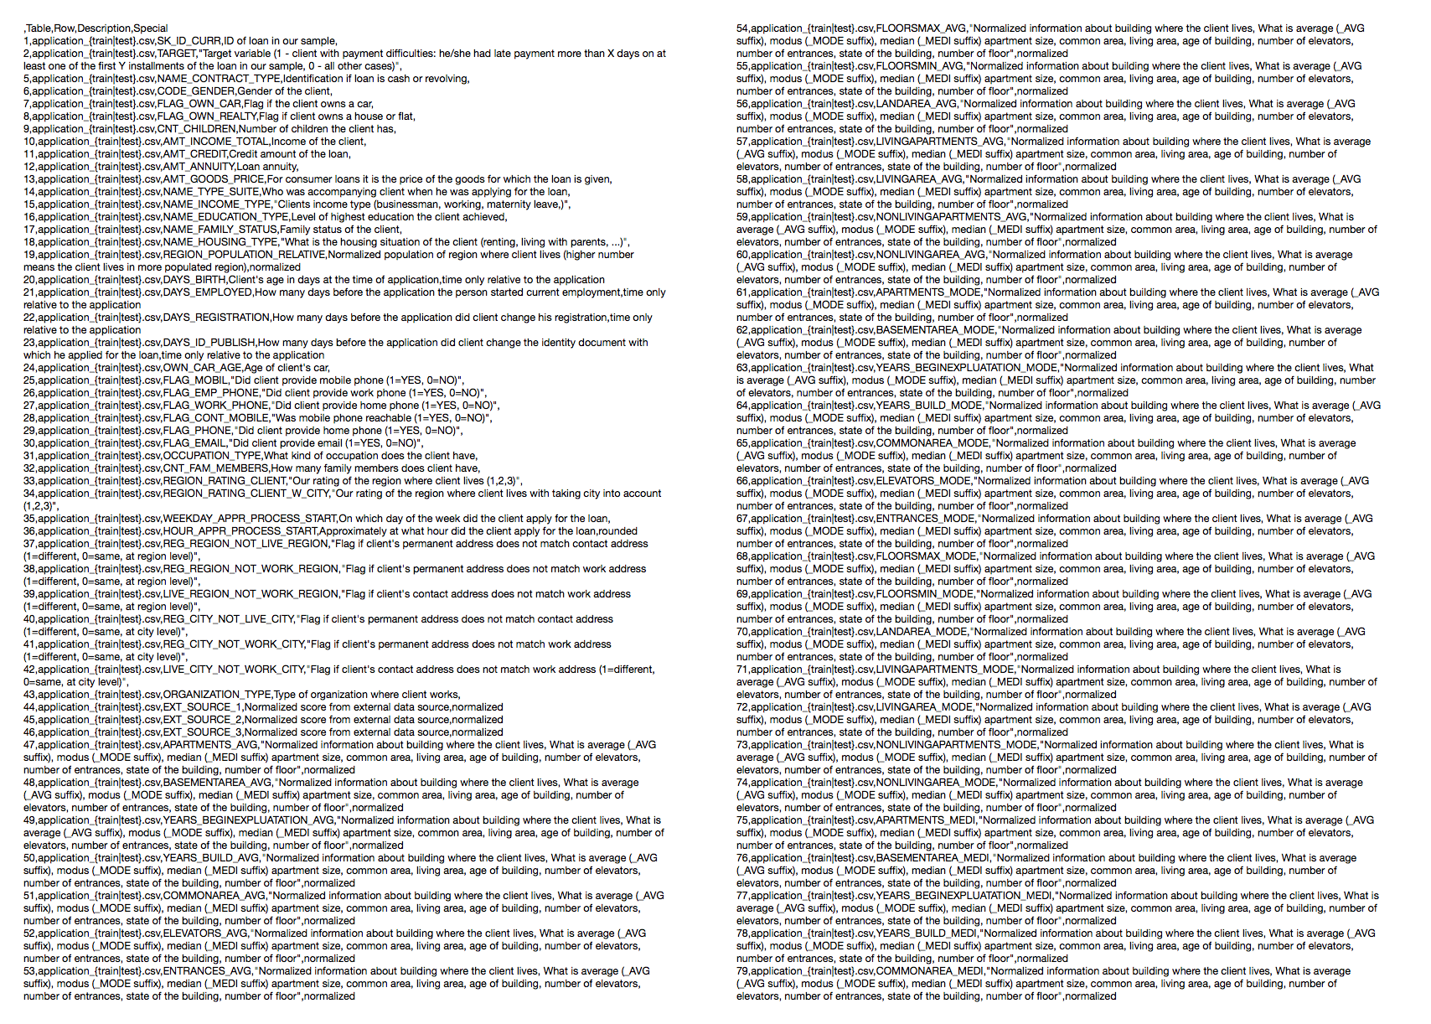
Features (221)
•Problem
Baseline model
Improved model
Future improvements
Challenge 1ΩΩz
Notes:
Some of these hide more features, like history of applications, payments by month on different products
Very feature-rich dataset with many opportunities to combine features

Slide 5
Feature Types
Numerical: Income, credit score, payment amount
Categorical: Income source, occupation
Binary: M/F, own car
•Problem
Baseline model
Improved model
Future improvements
Challenge 1ΩΩz

Slide 6
Baseline Model
Application table data only
No feature engineering: data as provided
No model tuning, default hyperparameters
Minimal scrubbing (a few weird outliers)
Binarize Y/N, F/M, etc. -> 0,1
Categorical -> one-hot dummies
SimpleImputer to fill in numeric data
Problem
•Baseline model
Improved model
Future improvements
Challenge 1ΩΩz

Slide 7
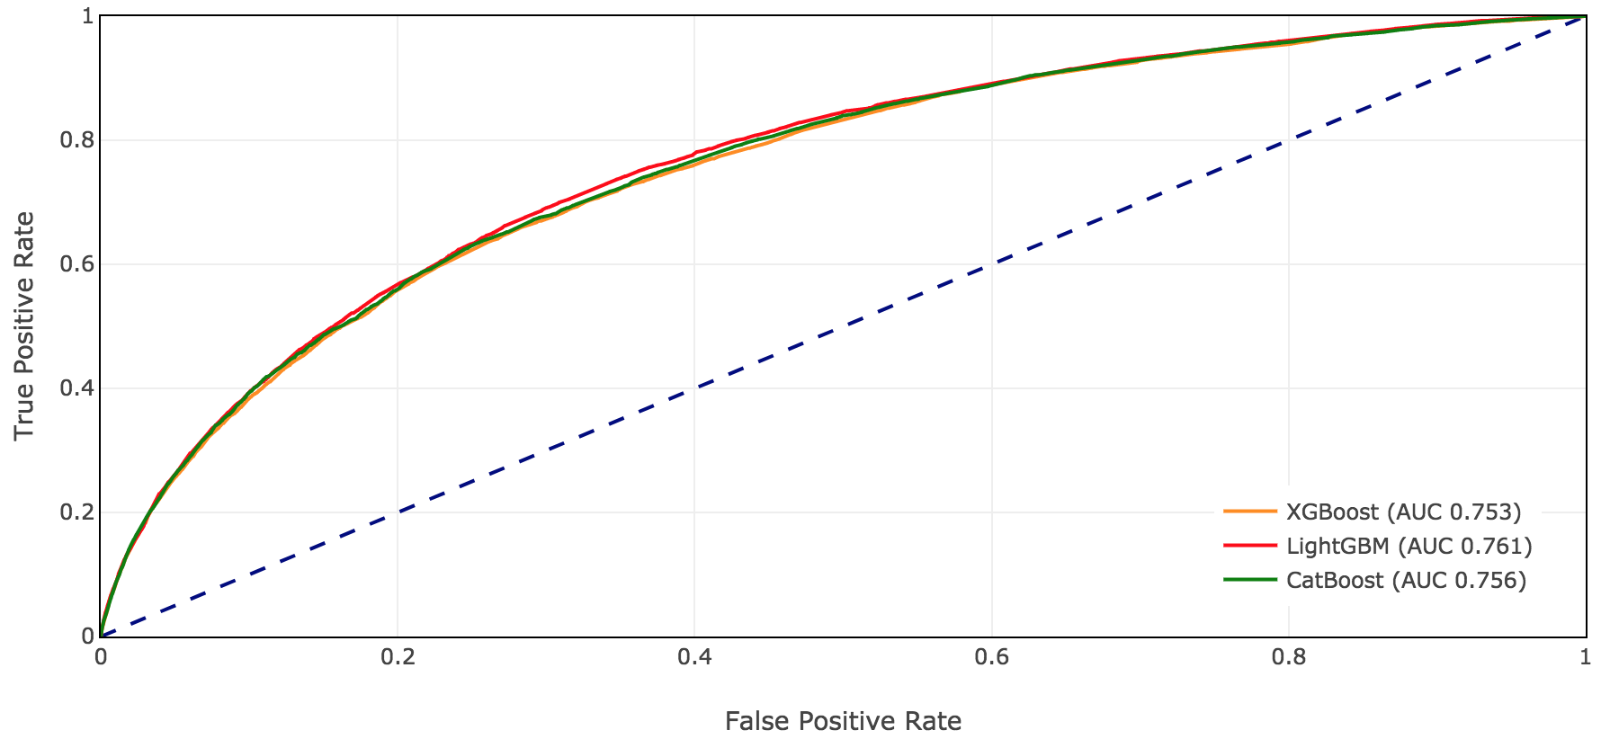
Baseline Model ROC Curves Are Similar
Problem
•Baseline model
Improved model
Future improvements
Challenge 1ΩΩz

Slide 8
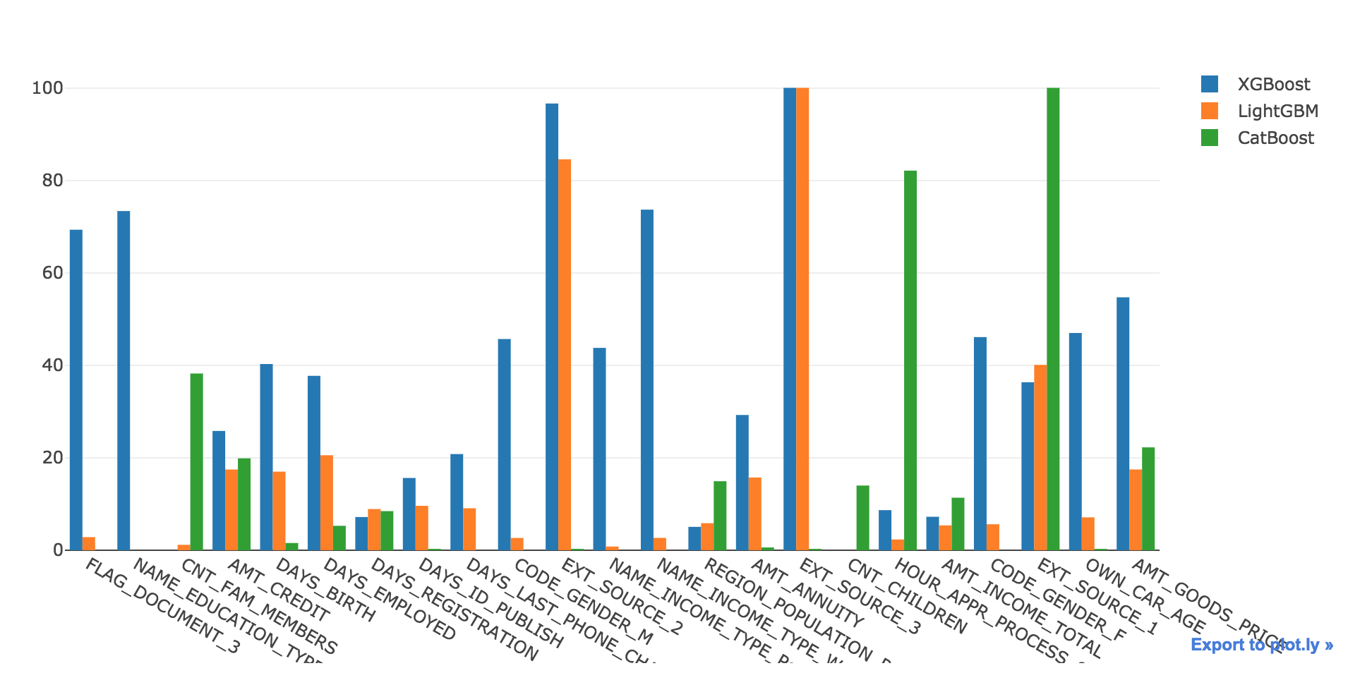
Baseline Feature Importances Differ Widely
Problem
•Baseline model
Improved model
Future improvements
Challenge 1ΩΩz

Slide 9
Baseline Model Metrics
Problem
•Baseline model
Improved model
Future improvements
Challenge 1ΩΩz
Metric (Xval) | XGBoost | LightGBM | CatBoost
Accuracy | 0.860 | 0.861 | 0.861
F1 | 0.305 | 0.311 | 0.311
AUC | 0.753 | 0.760 | 0.757

Slide 10
More Model Metrics - What Do We Care About?
Metrics are abstractions
Deny all loans, F1=0.149 ; approve all, F1=0
But bank is (maybe?) better off making all loans
You can’t spend F1!
We care about how much we make! Assign dollar values
Performing (Target=0) : $1,000 profit
Nonperforming (Target=1) : $11,387 loss
Choose classification threshold to maximize total value (instead of F1)
Problem
•Baseline model
Improved model
Future improvements
Challenge 1ΩΩz

Slide 11
More Model Metrics - Putting a Dollar Figure
Problem
•Baseline model
Improved model
Future improvements
Challenge 1ΩΩz
Metric (Xval) | Base | XGBoost Best F1 | XGBoost Best P/L
Accuracy | 0.081 | 0.860 | 0.713
F1 | 0.149 | 0.305 | 0.271
Performing | 56538 | 50971 | 40565
Nonperforming | 4965 | 3068 | 1690
Value | 0 | +$16.0M | +$21.3M

Slide 12
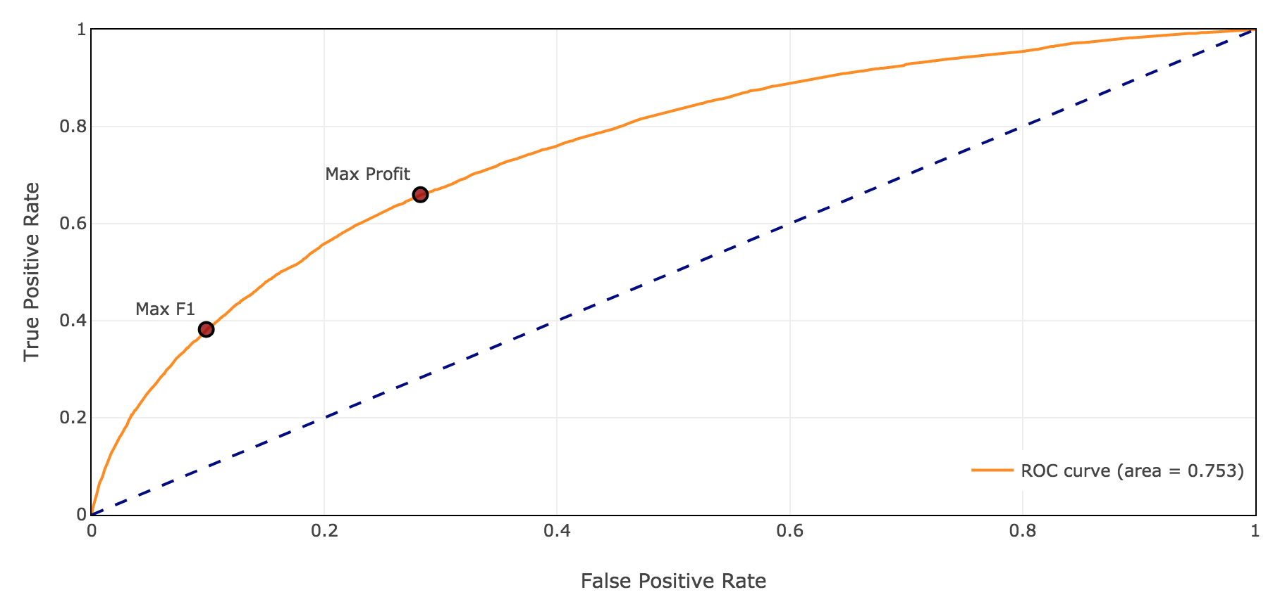
ROC Curve - Max F1 vs. Max Profit
Problem
•Baseline model
Improved model
Future improvements
Challenge 1ΩΩz
True Positive = Correct default prediction
Reject all
Accept all

Slide 13
Improved Model
Additional tables:
Previous applications
Credit bureau records
Previous Home Credit accounts:
Credit card
Point-of-Sale (‘10 easy payments’ accounts)
Problem
Baseline model
•Improved model
Future improvements
Challenge 1ΩΩz

Slide 14
Improved Model
Engineered features:
Divide key amounts by reported income
Aggregate historical tables
Count previous statuses
Applications, reasons for rejection
On time, late payments
Compute log1p where highly skewed (many counts of 0 late payments, some > 100)
Problem
Baseline model
•Improved model
Future improvements
Challenge 1ΩΩz

Slide 15
Results - P/L Improvement
Problem
•Baseline model
Improved model
Future improvements
Challenge 1ΩΩz
Metric (Xval) | Base | Baseline Best F1 | Baseline Best P/L | Final Best P/L
Accuracy | 0.081 | 0.860 | 0.713 | 0.684
F1 | 0.149 | 0.305 | 0.271 | 0.276
Performing | 56538 | 50971 | 40565 | 38345
Nonperforming | 4965 | 3068 | 1690 | 1260
Value | 0 | +$16.0M | +$21.3M | +24.0m

Slide 16
Results
New features used
Past default status
Past accepted/refused (got better deal?)
Kaggle AUC 0.78395
This is not even the median of entries
Contest winners are around 0.82
Problem
Baseline model
•Improved model
Future improvements
Challenge 1ΩΩz

Slide 17
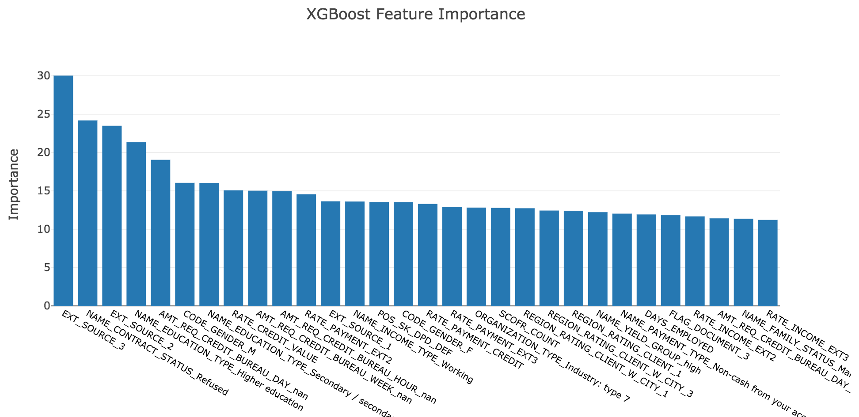
Complex model - Feature Importances
Problem
Baseline model
•Improved model
Future improvements
Challenge 1ΩΩz

Slide 18
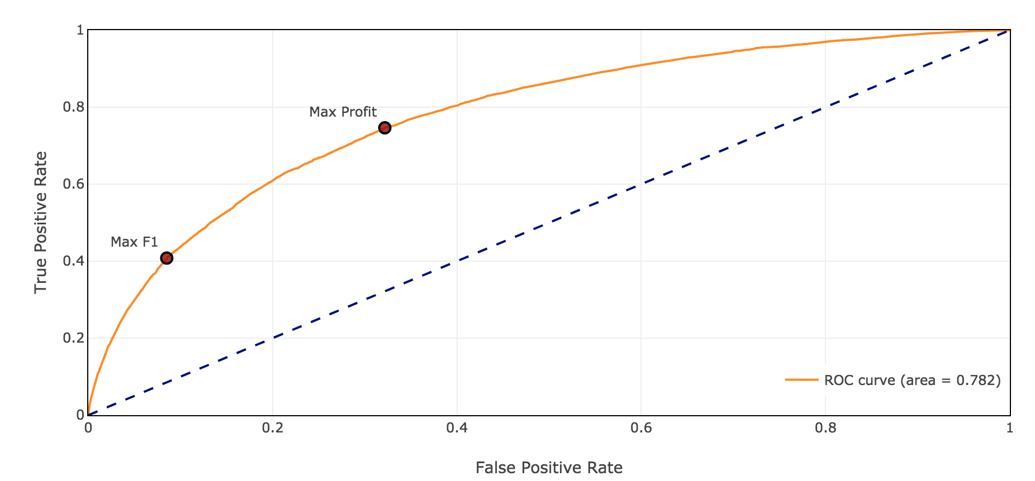
Complex Model - ROC Curve
Problem
Baseline model
•Improved model
Future improvements
Challenge 1ΩΩz

Slide 19
Future Improvements
Feature engineering. Use featuretools to try lots of features, ratios on a smaller dataset
Use resampling to address class imbalance
Stack / ensemble diverse algos
Inspect false negatives for clues
Read discussions and solutions to see how they achieved better AUCs
Problem
Baseline model
Improved model
•Conclusions
Challenge 1ΩΩz

Slide 20
Choose Metrics You Care About ($)
- We used arbitrary $ values, loan-level profit/loss even better
- If metric you care about is continuous and differentiable, make a custom loss function
- We optimize MSE as a proxy for something like accuracy which we care about but is not a good objective - not differentiable, convex
- You can have the best R-squared in the world but you can’t spend it!
Problem
Baseline model
Improved model
•Conclusions
Challenge 1ΩΩz

Slide 21
Conclusion
Questions?
It works Can be improved Potential impact: $Billions and $Billions

Slide 22
Implementation

Slide 23
Tools
Google Cloud Platform
Postgres
Pyscopg2 and sqlalchemy
Plotly (and matplotib)
XGBoost
LightGBM
CatBoost
sklearn, pandas, numpy
Challenge 1ΩΩz

Slide 24
Data source
https://www.kaggle.com/c/home-credit-default-risk
Home Credit: http://www.homecredit.net/
Challenge 1ΩΩz

